Slide 1



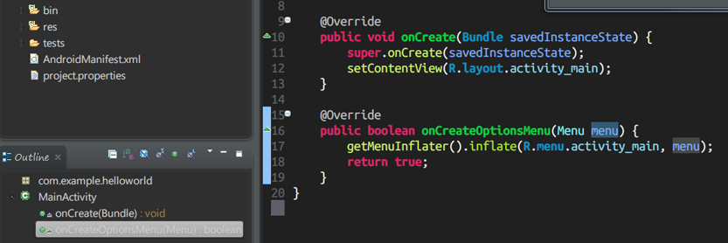
Java Basics
Course Introduction
SoftUni Team
Technical Trainers
Software University
http://softuni.bg

Slide 2







SoftUni Diamond Partners

Slide 3




Table of Contents
Course Objectives
Course Program
Trainers Team
Examination
Learning Resources

Slide 4


Warning: Not for Absolute Beginners
The "Java Basics" course is NOT for absolute beginners
Take the "C# Basics" course at SoftUni first: https://softuni.bg/courses/programming-basics
The course is for beginners, but with previous coding skills
Requirements
Coding skills – entry level
Computer English – entry level
Logical thinking
coding skills
required!

Slide 5
Level #1 at the Software University
Java Basics
6 times + TW + labs + exam
4 weeks * 2 times
Web Fundamentals (HTML + CSS)
10 times + TW + labs + exam
4 weeks * 3 times
JavaScript Basics
6 times + TW + labs + exam
4 weeks * 2 times
PHP Basics
6 times + TW + labs + exam
4 weeks * 2 times
Teamwork and Personal Skills
4 times
16 weeks * 1 times
Teamwork and Personal Skills (Part II)
6 times

Slide 6


Java Basics Course
Java Basics
Course Objectives & Program

Slide 7

Course Objectives
The "Java Basics" course:
First steps in Java programming:
Compiler, IDE, variables, control-flow logic, console I/O, loops
Methods, arrays, lists, sets, maps, strings
Develop algorithmic thinking and problems solving skills
Prepare for learning other languages and software technologies
HTML, CSS, JavaScript, PHP, Python, Ruby, …
Databases & SQL, high-quality code
Web development technologies & mobile platforms

Slide 8

Java Basics – Course Topics
Course Introduction. Introduction to Java, JDK and Eclipse
Primitive Data Types and Variables Operators, Expressions and Statements Console-Based Input and Output Conditional Statements (if-else, switch-case)
Loops (while, do-while, for, foreach) Methods. Basic Exception Handling Using Built-In Java Classes. Defining Own Classes
Arrays, Strings, Lists, Dictionaries, Sets
Team work + Labs + Workshops
Practical Exam

Slide 9

The Trainers Team

Slide 10

Trainers Team
Svetlin Nakov, PhD
Training & Inspiration Manager @ Software University
20+ years software development experience
10+ years experience as trainer
Author of 7 programming books
Speaker at hundreds of events
Web site & blog: www.nakov.com

Slide 11

Trainers Team (3)
Bogomil Dimitrov
Junior trainer @ SoftUni
Top performing student from the Software University (2014)

Slide 12
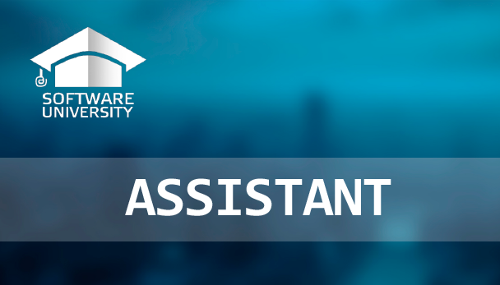
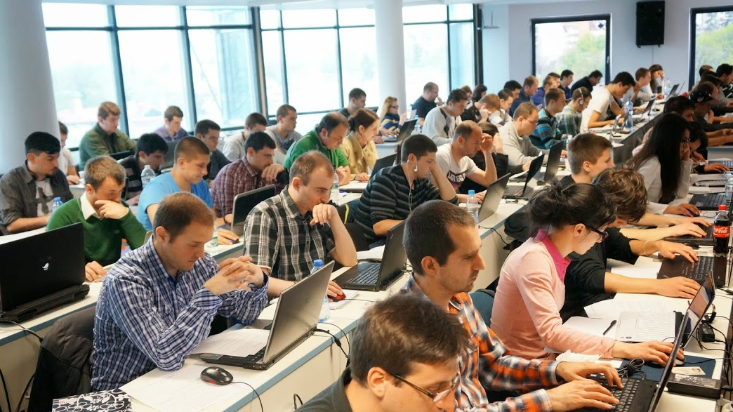
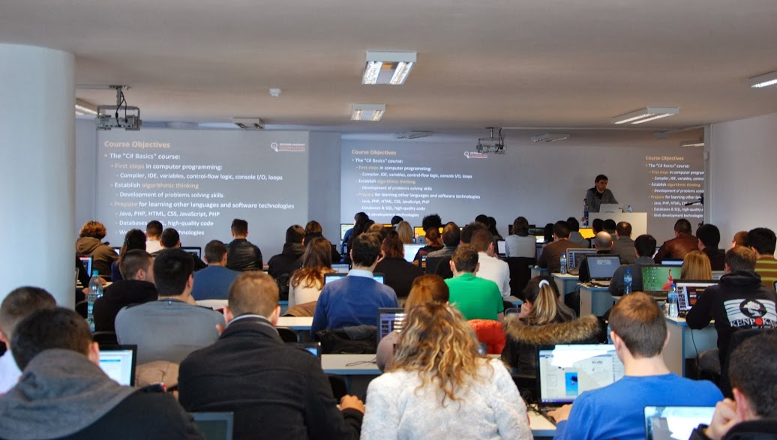
Volunteer Teaching Assistants
15+ volunteer teaching assistants
Scholarship students from SoftUni
Top students from SoftUni

Slide 13

Java Basics Course: More Details
Duration, Languages, Technologies

Slide 14


Training Duration – Java Basics
Lectures: ~ 30-40 hours (onsite + YouTube videos)
Practical exercises (in class): ~ 20-30 hours
Homework: ~ 30-50 hours
Team project: ~10-20 hours
Exam preparation: ~ 20 hours
Exam: 5 hours
Schedule: 12-28 January 2015
Exam date: 8 February 2015

Slide 15

Why Java?
The Java platform is very popular
Free and open-source software (see OpenJDK)
Runs everywhere, on millions of devices
Supported by big players: Oracle, IBM, Google, SAP
Runs many languages: Java, Python, Ruby, Groovy, Closure, …
The Java language
Modern object-oriented language
7-10 millions Java developers in 2012 (source)

Slide 16



Why English?
Why the slides are in English?
English is the native language of the software engineers
Specific terminology should be in English
Translations are inaccurate and funny
Just learn English!
No excuses

Slide 17
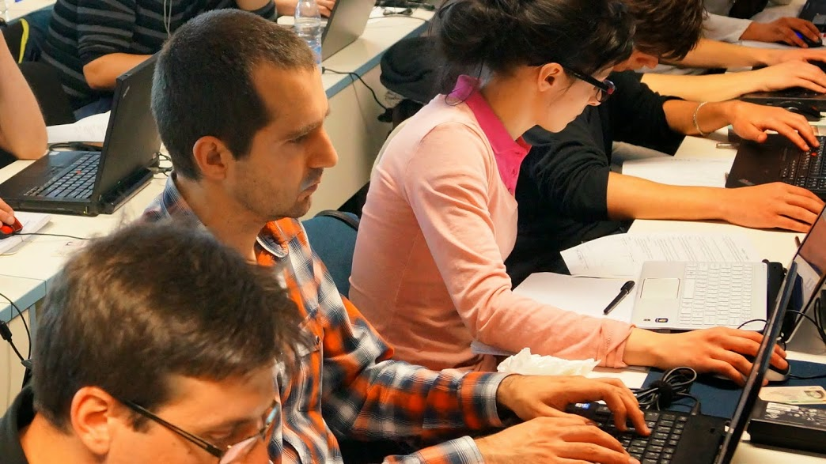


Java Basics
Evaluation Criteria

Slide 18


Scoring System for the "Java Basics" Course
Exam – 80%
Labs – 10% (added to the exam results)
Homework + evaluation – 5% + 5%
Team work – 10%
Bonuses – up to 10%
Presence in class – 5% (onsite students only)

Slide 19
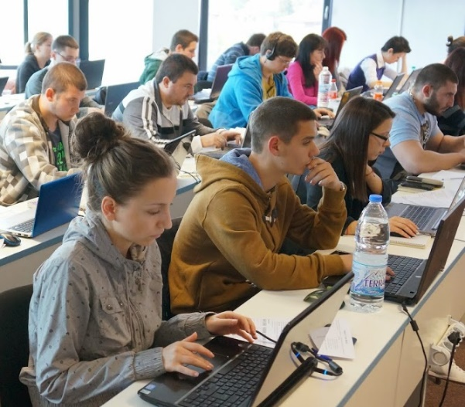

The Java Basics Exam
Practical programming exam
4 practical problems for 5 hours
1 easy, 2 with loops, 1 with arrays / sets / strings
You should code in Java
Automated judge system with real-time feedback
http://judge.softuni.bg
Solutions are evaluated for correctness only
Code quality is still not measured

Slide 20

Homework Assignments
Doing your homework is very important!
Programming can only be learned through a lot of practice!
You should write code every day!
Each lecture is followed by a few exercises
Try to solve them in class
The rest are your homework
Homework assignments are due in 1 week after each lecture
Submission will be accepted through our web site: softuni.bg

Slide 21

Homework Peer Reviews
Give feedback to a few random homework submissions
Students submit homework anonymously
Please exclude your name from the submissions!
For each homework submitted
Students evaluate 3 random homeworks
From the same topic, after the deadline
Give written feedback, at least 200 characters
Low-quality feedback → report for punishment
Everyone will get feedback for their homework

Slide 22









Resources
What We Need Additionally?

Slide 23

Course Web Site & Forums
The Java Basics official web site:
Register for the "Software University Forum":
Discuss the course exercises with your colleagues
Find solutions for all course exercises
Share source code / discuss ideas / help each other
https://softuni.bg/trainings/1080/Java-Basics-Jan-2015
https://softuni.bg/forum

Slide 24



The Java Programming Slides and Videos
All lecture slides, videos, homework assignments, projects and other resources are open content, available for free
Visit the course web site to access the course resources

Slide 25


Free Java Fundamentals Textbook
The official textbook for the Java Basics course
The official Java Tutorial from Oracle:
http://docs.oracle.com/javase/tutorial/java/
“Fundamentals of Computer Programming with Java”, by Svetlin Nakov & Co., 2009, ISBN 9789544000554
Bulgarian version only available (as PDF, ePub, …)
Freely downloadable from: www.introprogramming.info
Read chapters 1…13 (up to Strings), optionally all others

Slide 26
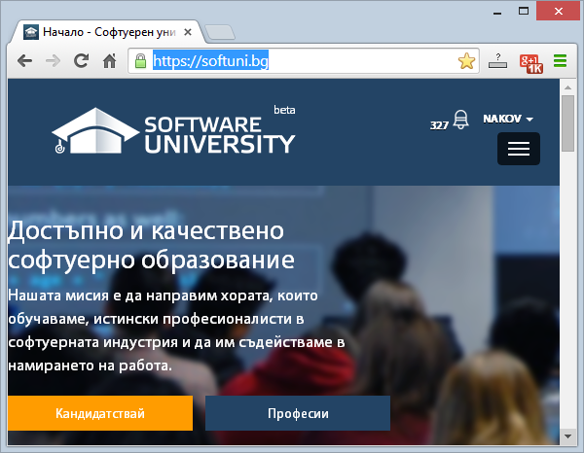
Software University Learning System (SULS)
Software University Learning System (SULS)
www.softuni.bg
Important resource for students
Homework submissions
Homework check-up
Exams and results
Reports about your progress
…

Slide 27
Required Software
Recommended software for the Java Basics course:
Linux (your favorite distribution), e.g. Xubuntu 14.04
Optionally you can use Windows or other OS
JDK 8 (Java SE Development Kit 8)
Install JDK (nor JRE!) – https://jdk8.java.net/download.html
Optionally you can use older Java version (e.g. JDK 6 or 7)
Eclipse for Java 8 – www.eclipse.org/downloads/
Any other Java IDE may also be used: IntelliJ IDEA, Netbeans, …

Slide 28

Summary
The "Java Basics" course provides
The first steps in Java programming
Training program
Java platform, using Eclipse, variables, control-flow logic, loops, advanced topics
Practical exams
Automated judge system + score system
Learning resources
Lectures, videos, software, books, forum
Java Basics

Slide 29
Java Basics – Course Introduction
https://softuni.bg/courses/java-basics/

Slide 30
License
This course (slides, examples, demos, videos, homework, etc.) is licensed under the "Creative Commons Attribution-NonCommercial-ShareAlike 4.0 International" license
Attribution: this work may contain portions from
"Fundamentals of Computer Programming with C#" book by Svetlin Nakov & Co. under CC-BY-SA license
"C# Part I" course by Telerik Academy under CC-BY-NC-SA license

Slide 31





Free Trainings @ Software University
Software University Foundation – softuni.org
Software University – High-Quality Education, Profession and Job for Software Developers
softuni.bg
Software University @ Facebook
facebook.com/SoftwareUniversity
Software University @ YouTube
youtube.com/SoftwareUniversity
Software University Forums – forum.softuni.bg

